Slide 1

Player Performance Analysis Tool
Presented By:
Michael Khanda

Slide 2
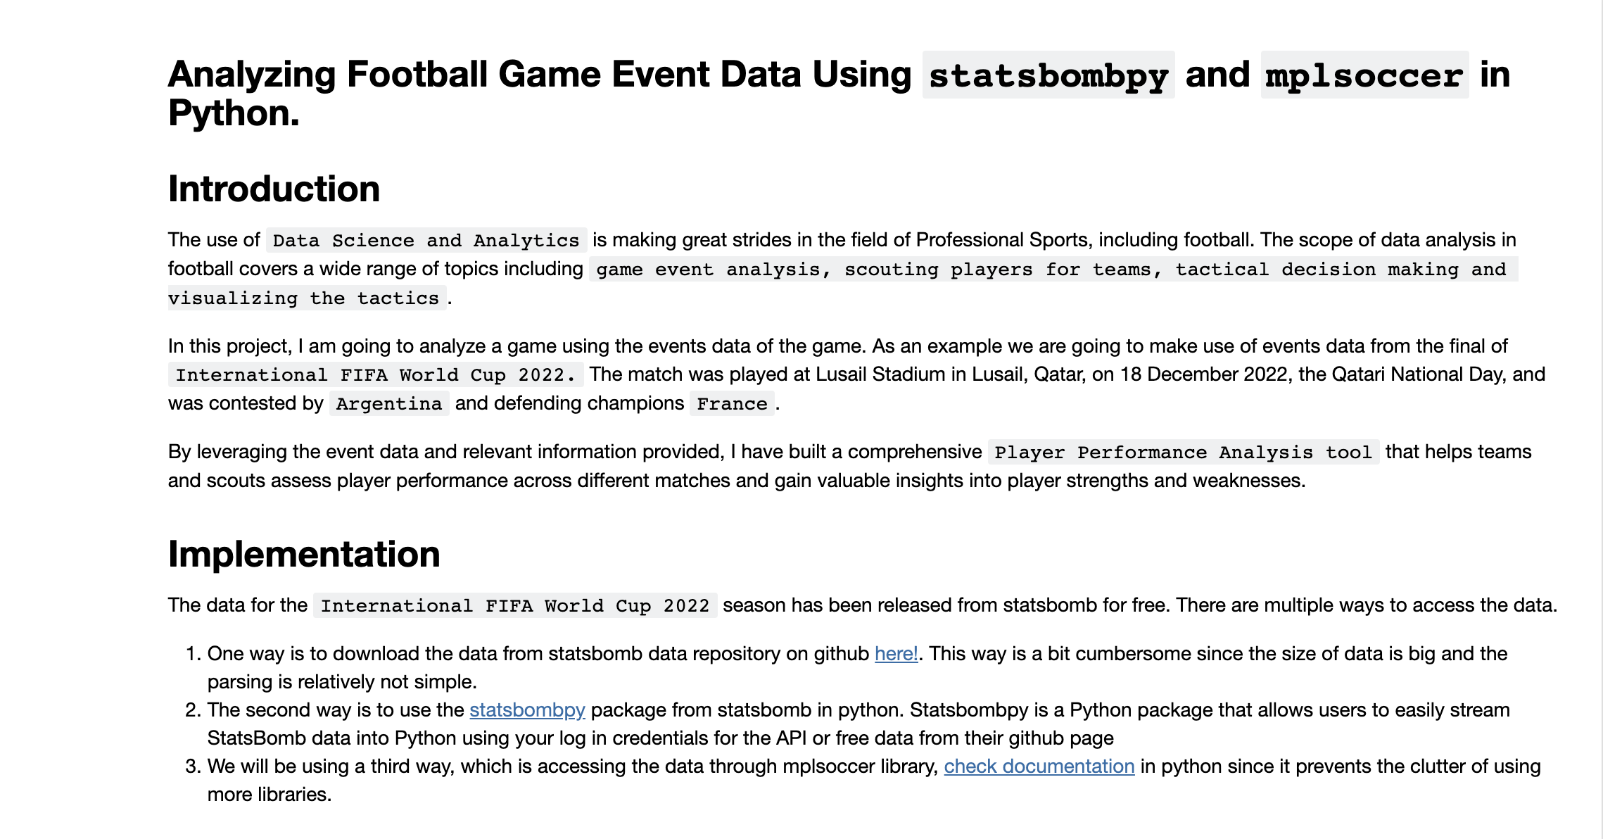
INTRODUCTION

Slide 3
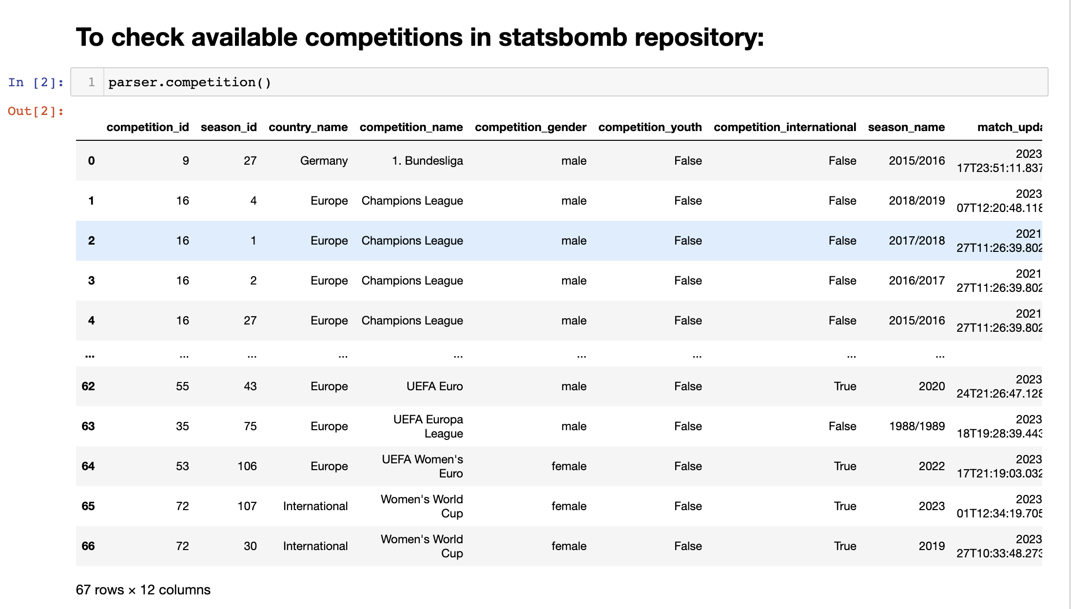
AVAILABLE COMPETITIONS

Slide 4
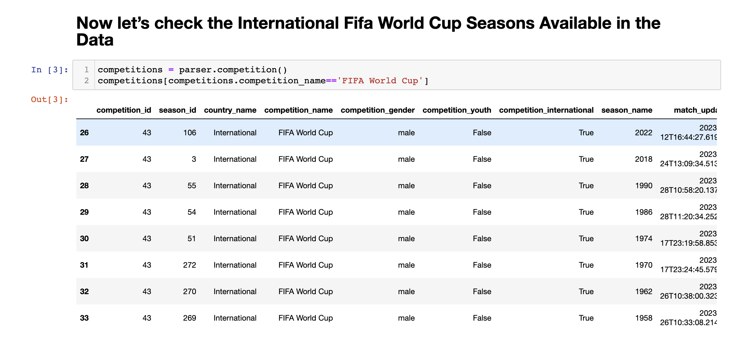
FIFA WORLD CUP SEASONS AVAILABLE

Slide 5
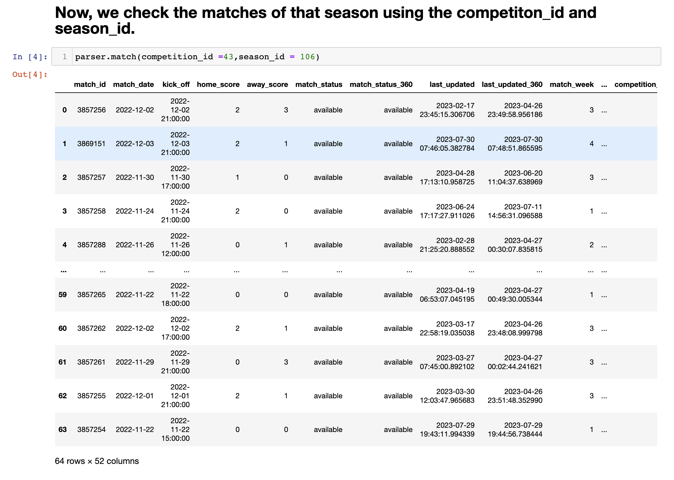
LOOK FOR SPECIFIC MATCH

Slide 6
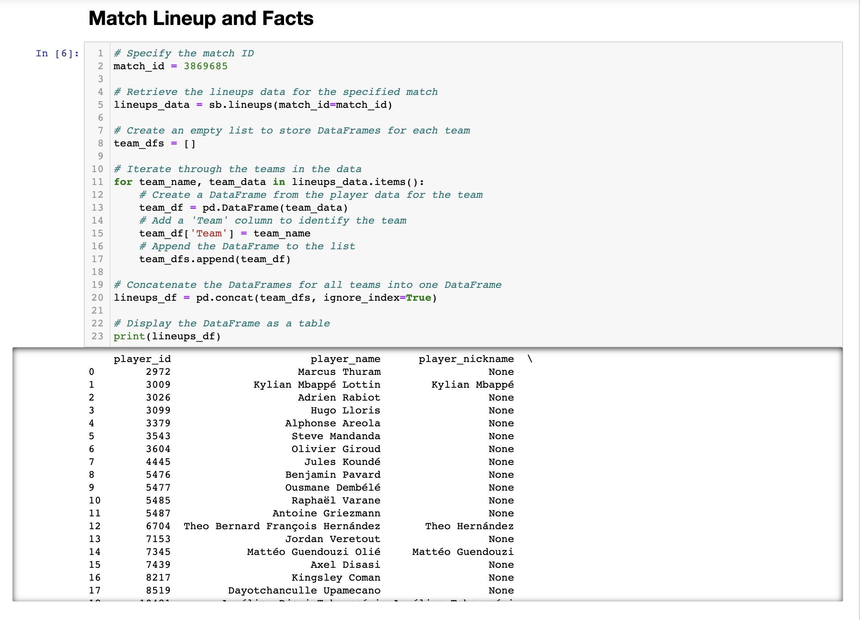
OBTAIN MATCH LINEUP & FACTS

Slide 7
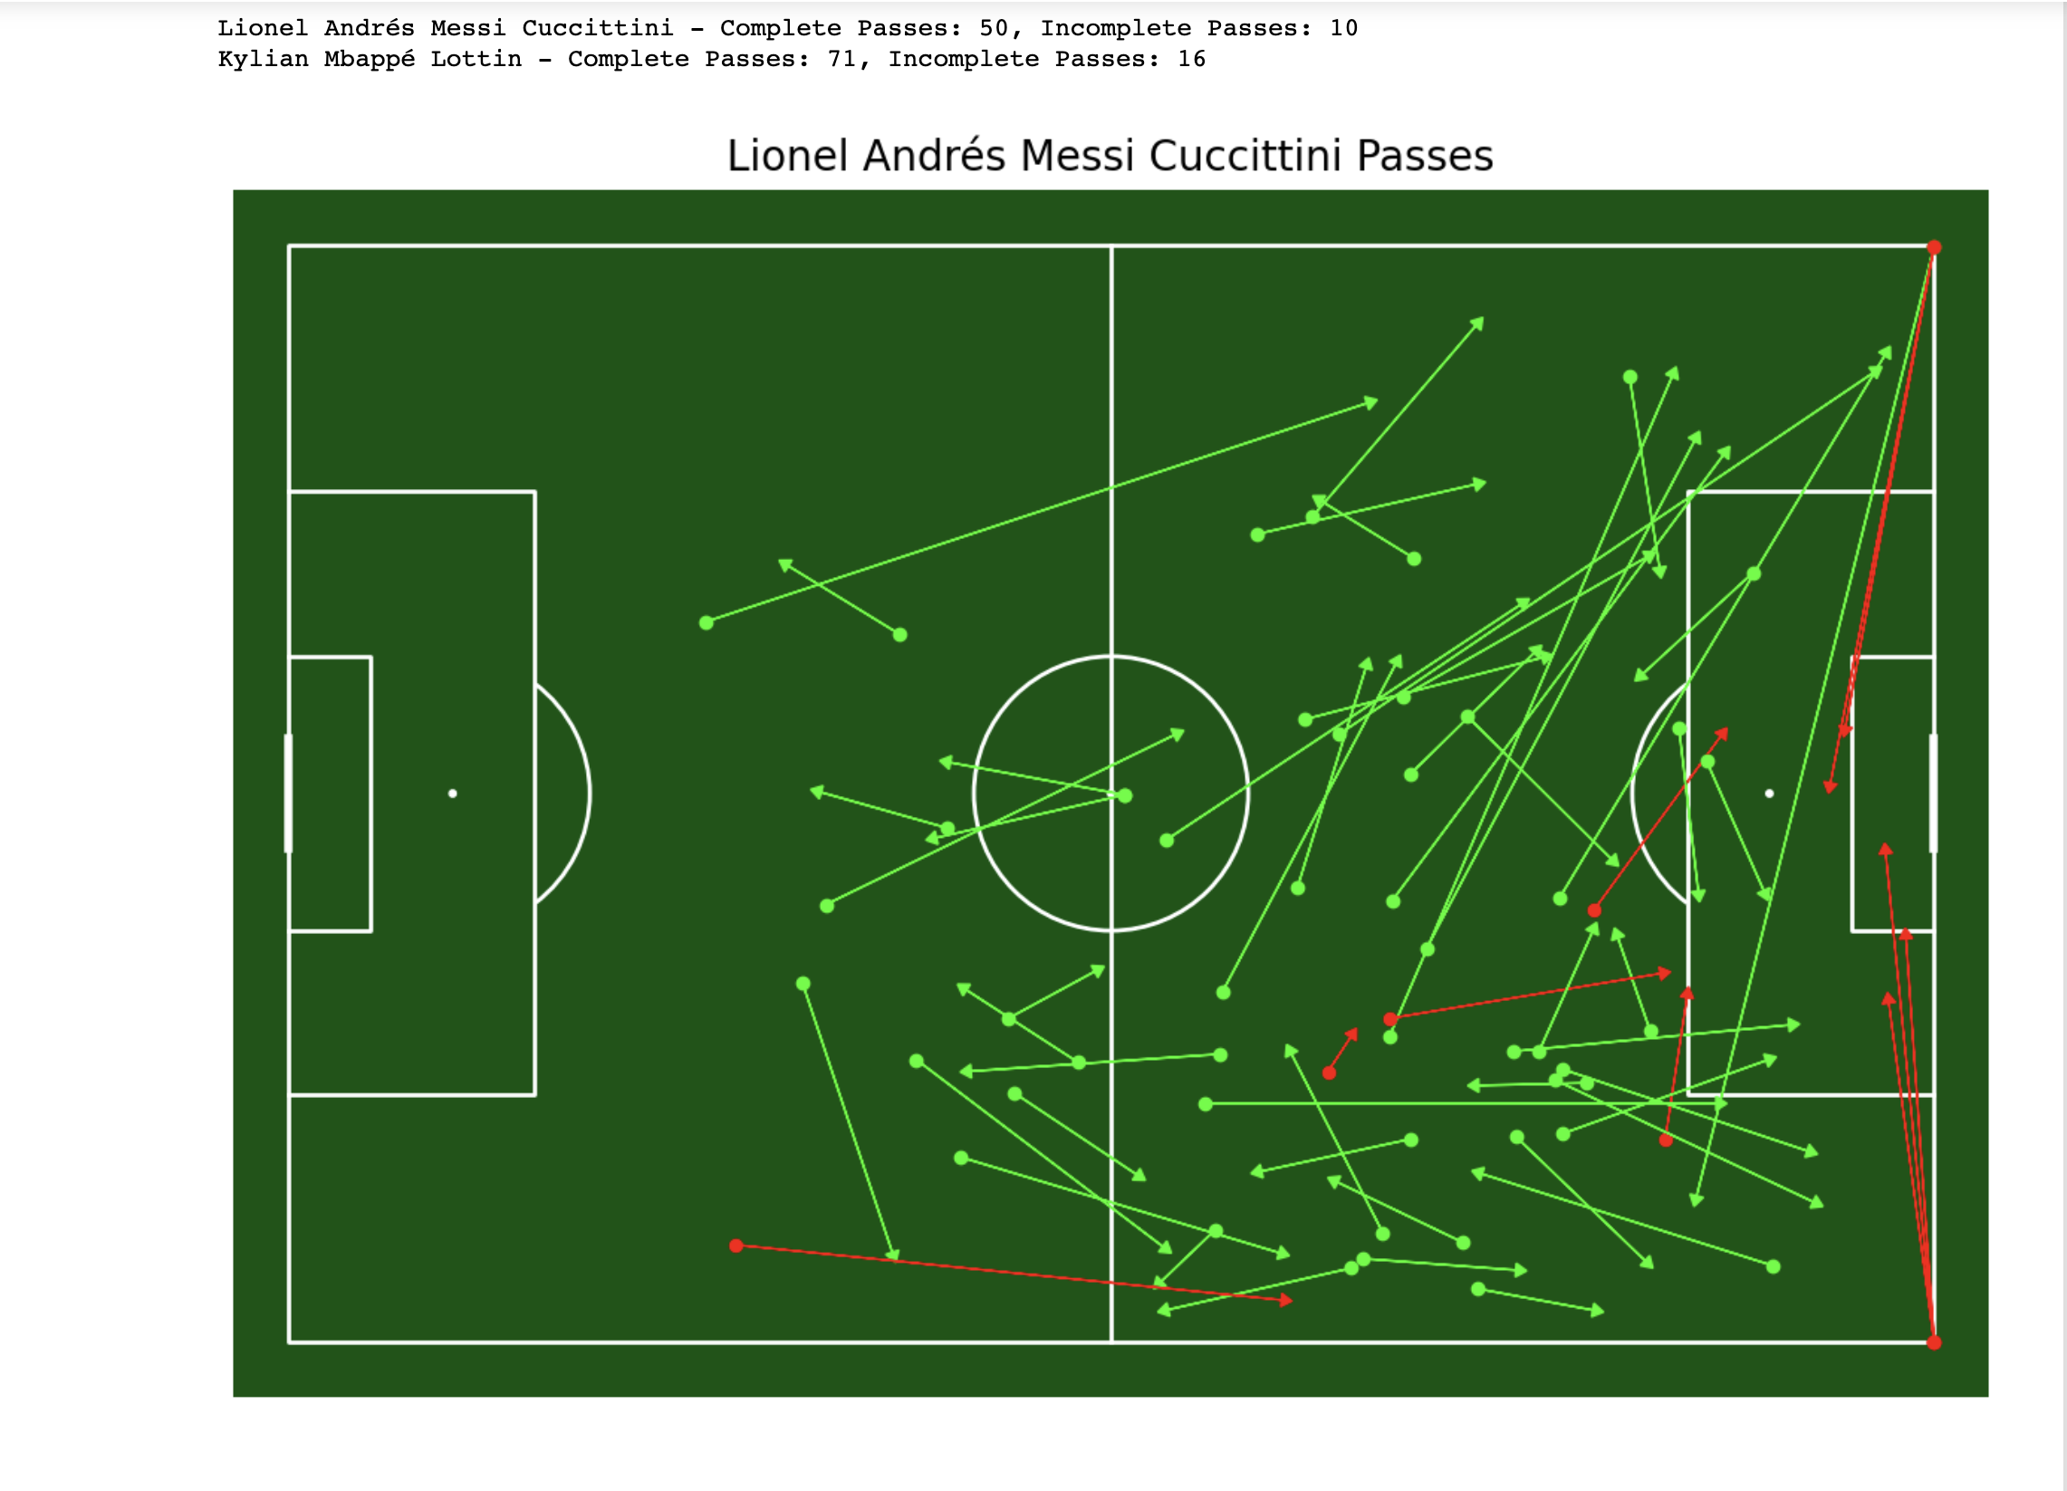
PASS MAPS

Slide 8
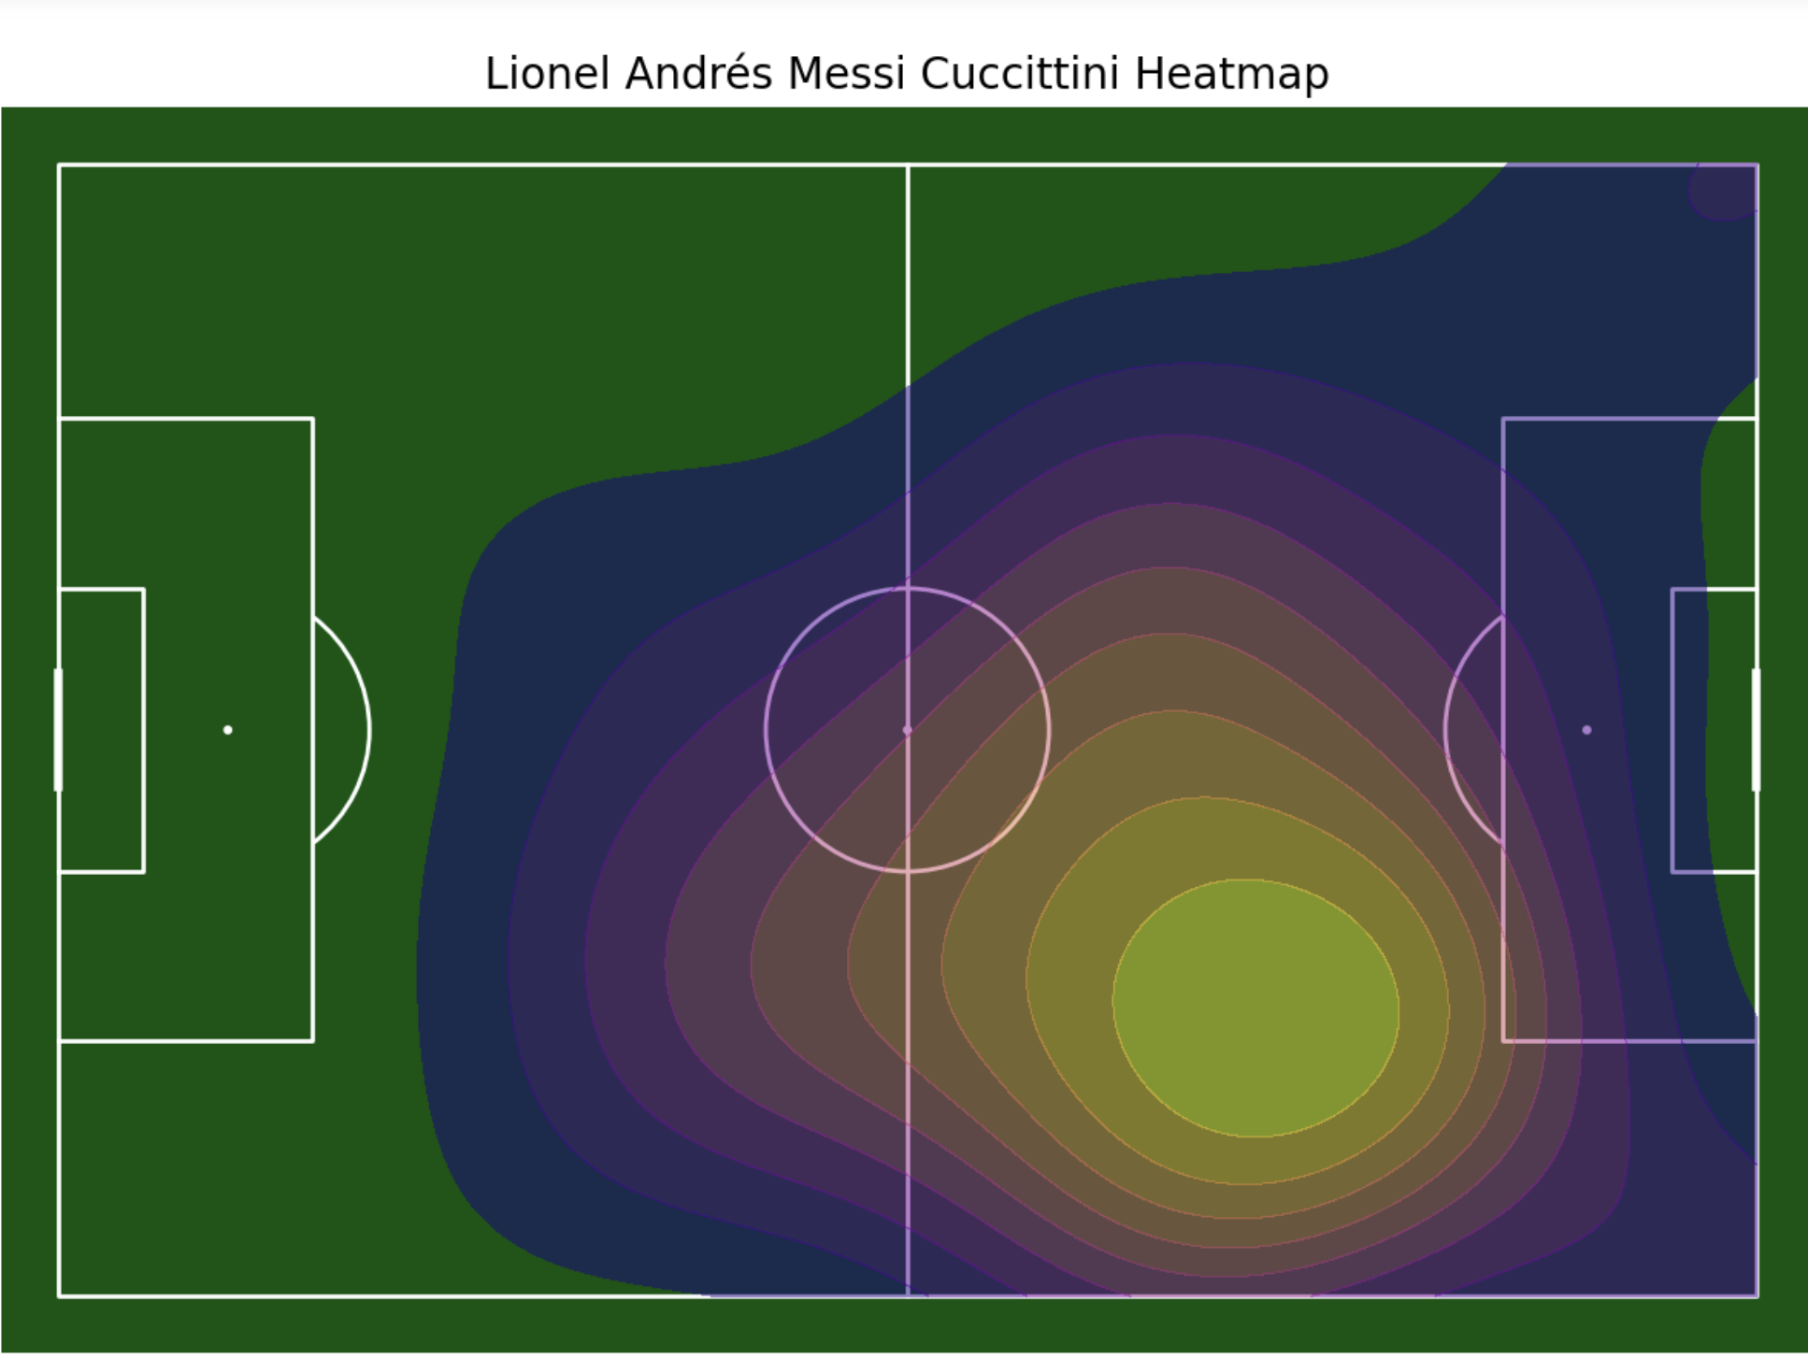
HEATMAPS

Slide 9
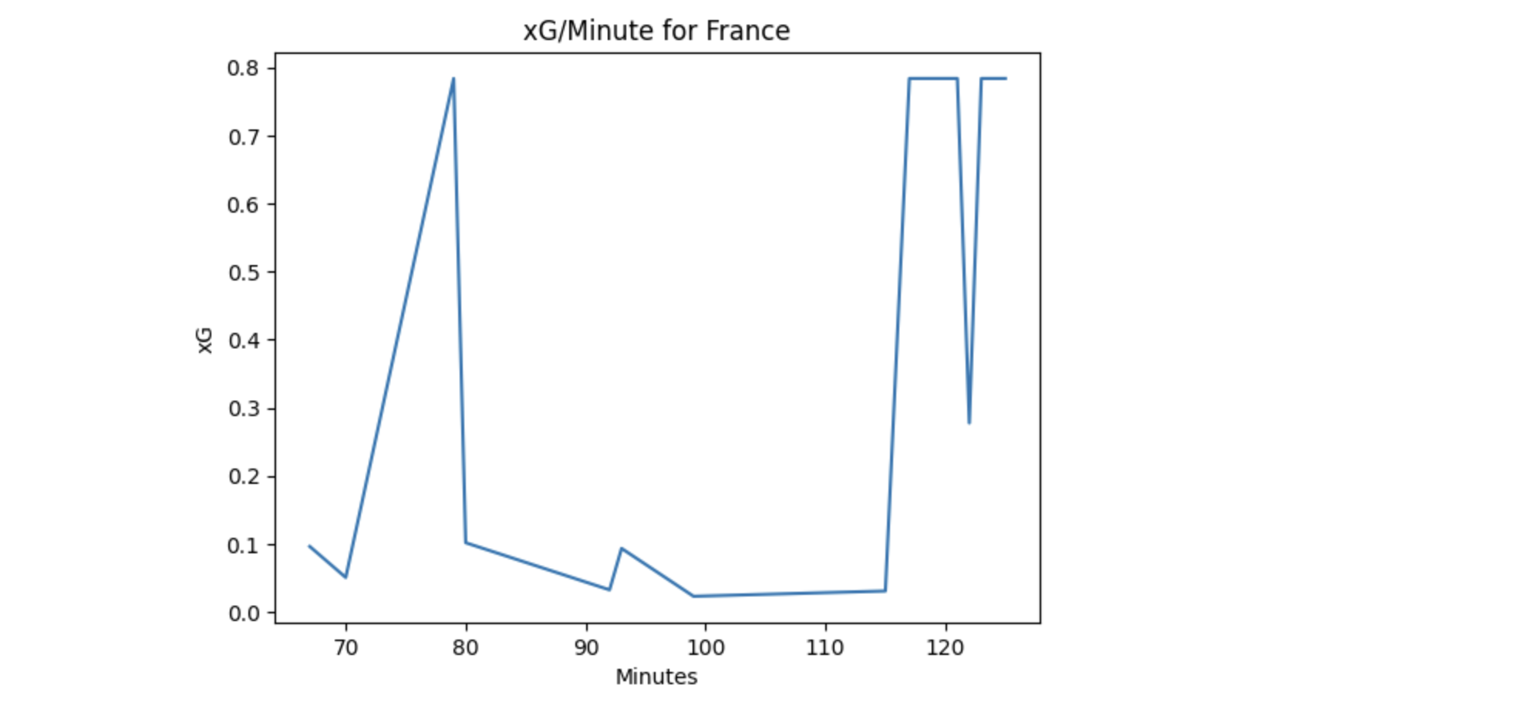
ANALYSING THE XG IN THE GAME

Slide 10
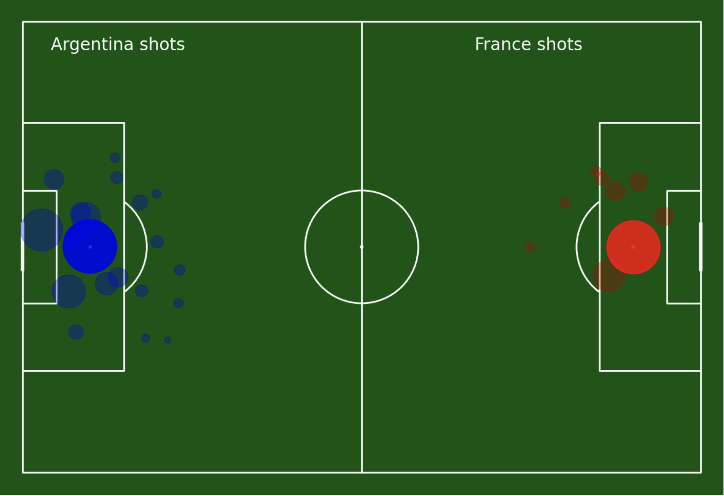
SHOTMAPS

Slide 11
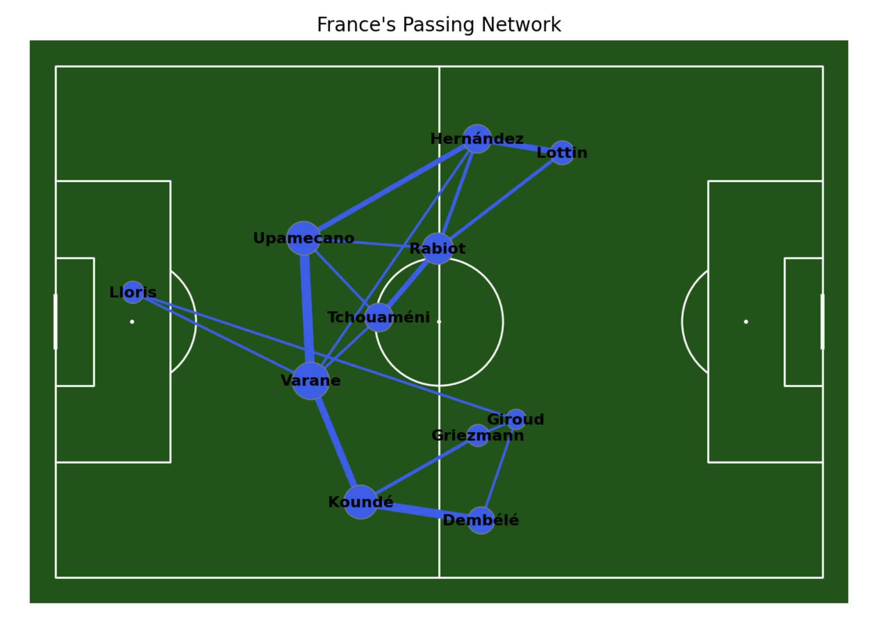
PASS NETWORKS

